Slide 1


SKYPIA
Mess Exposure To the Hostellers

Slide 2
Introduction
Nowadays, hotel services are digitally active were as mess services lag behind. Newcomers to an unknown place for the job, study, travel, etc., usually face the problem in finding mess services near to their location. Also, some user doesn't always get the meal for their budget or satisfactory services they look for the external food source. Our system will interact with the user's location and provide information about active mess services prior to their location. The record of customers can have managed and maintained by the system and placed the order online.
This Android Application has been made in a user friendly interface. So that item easily added and deleted by a customer. The menu card of different mess consists of various food varieties available in the mess. It overcomes the drawback of the traditional queuing system. The payment can be made online or cash-on-delivery system. It maintains a separate account for each user so that the user's details are maintained confidential.

Slide 3
Problem Definition (Reason why you chose this Problem Statement)
To locate nearby food mess for people.
We chose this topic because we have seen a lot of people coming from different places struggling to get home like food. As we know that everyday restaurant food is not affordable as well as not healthy, these people need to have a daily supply of food at affordable prices as well as home-like. Sometimes coming in a new area your not aware of the vicinity so its difficult to find a food mess. And sometimes the mess they choose doesn’t provide good food.
So, our app is going to eliminate all those struggle of the new comers and help them find a mess ,which is good and affordable .

Slide 4
Proposed Solution
The proposed system consists of the following module:
A. Customer start the application by registering the data In the home page, there is a menu bar which contains tab and starts to use the application.
B. Different variety of Meal Menu Display to customer In this module includes show Lunch or Dinner option. Depend upon the selection mess list needs to have appeared, also show main filters as Vegetarian and Non-Vegetarian. Sorting will include Price, Rating, and Favorites.
C. Customer Book the Meal In this module, User has to select one option from Lunch and Dinner which will be shown in tabular format. Clicking on Add button for that particular date this entry should be added into the cart. Once done with booking, after clicking on Proceed to payment, Dialog should open showing date wise booking and cost.

Slide 5
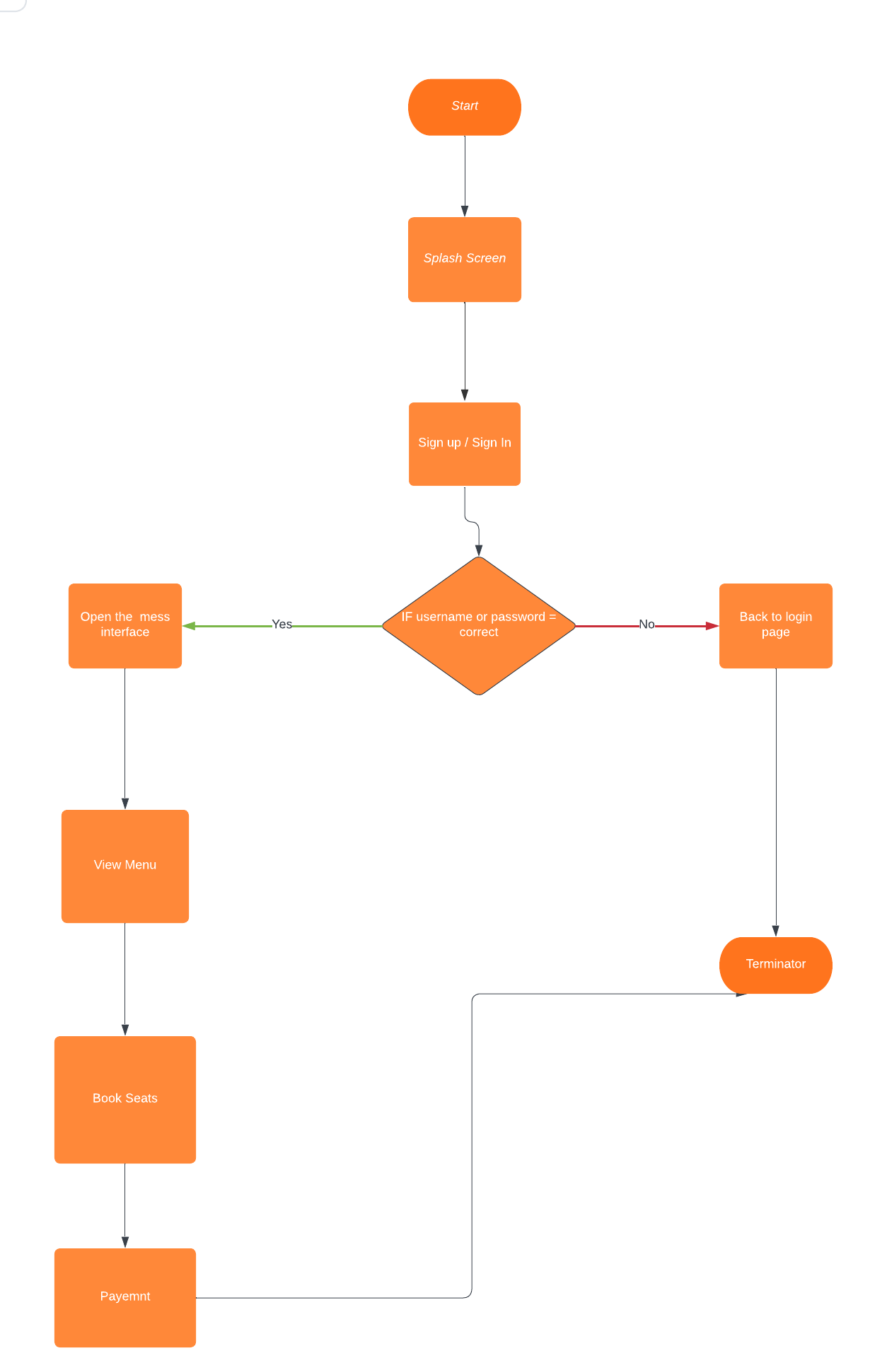
Architecture / Flow Chart

Slide 6
Hardware and Software Technology Used
Software used :
Android Studio
Firebase

Slide 7
Future Scope
This system can extend to the many regions and register various mess.
If the customer can order the food within the specific distance, then in future we maintain the distance criteria and fulfill the requirement of the customer to get the good food delivery or boarding.
The scope will be we create many service providers under the admin and expand the food delivery criteria. Many people have used a smartphone so it can extend in the future.

Slide 8
Thank You

